Slide 1
Telco Customer Churn Analysis
Using SQL & Tableau to uncover Customer Churn insights Jaykumar Rathwa| Data Analyst

Slide 2
Project Overview
Dataset: Telco Customer Churn (Kaggle)
Goal: Understand churn patterns to help the company reduce customer loss.
Tools Used: SQL, MySQL, Tableau, GitHub
Key Questions:
How many customers churned vs stayed?
Does churn vary by contract type or senior status?
Do higher spenders churn more?
How long do churned customers typically stay?
Who were the top value customers lost?

Slide 3
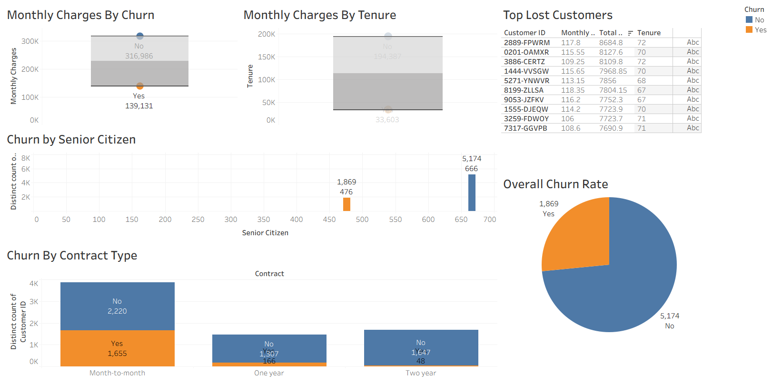
Churn Trends & Drivers

Slide 4
As per the visuals from the previous slide –
~27% of customers churned, mostly on month-to-month contracts.
Senior citizens churn at a slightly higher rate. (~42%)
Higher spenders tend to churn less.

Slide 5
Key Takeaways & Next Steps
Summary: Target month-to-month customers with loyalty offers.
Business Value: Insights help the company design retention campaigns.
Project Repository:
https://github.com/rathwaj21/Telco_Customer_Churn_Analysis_SQL_Project
Dashboard:
https://public.tableau.com/app/profile/jay.rathwa/viz/Telco_Cus_Churn/Dashboard1?publish=yes

